Slide 1

Python Programming
Machine Learning with Scikit-Learn

Slide 2
Feedback is greatly appreciated!

Slide 3

Objective
An architecture for ML Data Products
Review of Regression and Clustering
Classification
Scikit-Learn libraries for classifiers
Model Evaluation
Scikit-Learn libraries for evaluation

Slide 4
Machine Learning
Smoothing
Planning
Probability
Computer Vision
Normalization
Reinforcement
Artificial Intelligence
Distributions
Statistics
Neural Models
Bayes Theorem
Computer Vision
Regression
Anomaly Detection
Logits
Natural Language Processing
Entropy
Computer Science
Big Data Optimization
Data Mining
Function Approximation
Graph Algorithms

Slide 5
An architecture for operationalizing Machine Learning algorithms

Slide 6
Build Phase
Training Data
Feature Vectors
Estimation Algorithm
Labels
Operational Phase
New Data
Feature Vectors
Predictive Model
Prediction
Architecture of Machine Learning Operations

Slide 7
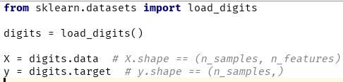
Dimensions and Features
In order to do machine learning you need a data set containing instances (examples) that are composed of features from which you compose dimensions.
Instance: a single data point or example composed of fields
Feature: a quantity describing an instance
Dimension: one or more attributes that describe a property

Slide 8
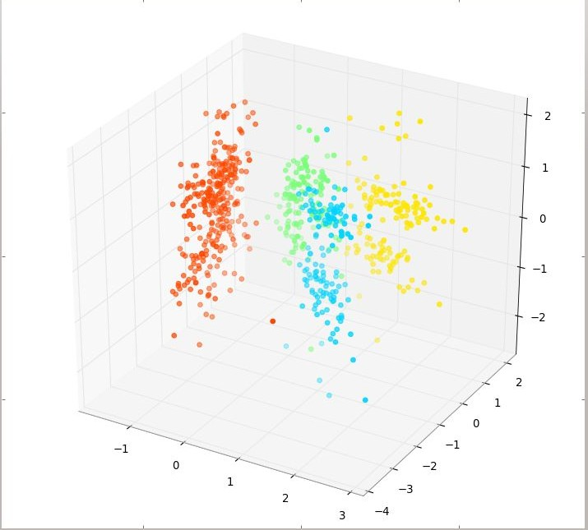
Feature Space
Feature space refers to the n-dimensions where your variables live (not including a target variable or class). The term is used often in ML literature because in ML all variables are features (usually) and feature extraction is the art of creating a space with decision boundaries.
Target
1. Y ≡ Thickness of car tires after some testing period
Variables
X1 ≡ distance travelled in test
X2 ≡ time duration of test
X3 ≡ amount of chemical C in tires
The feature space is R³, or more accurately, the positive quadrant in R³ as all the X variables can only be positive quantities.
http://stats.stackexchange.com/questions/46425/what-is-feature-space

Slide 9
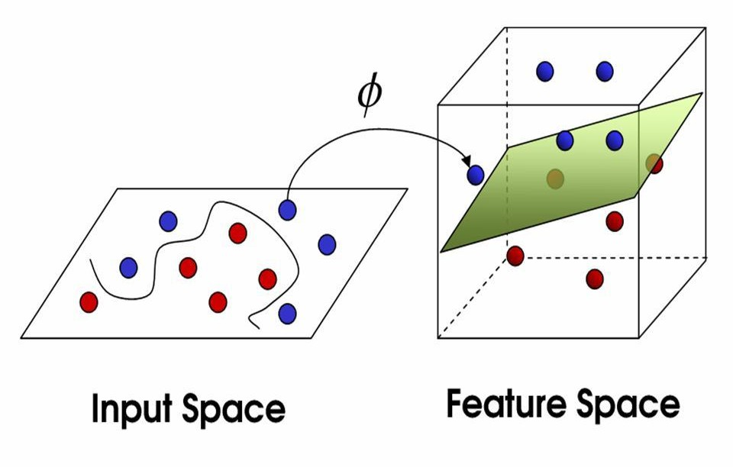
Mappings
Domain knowledge about tires might suggest that ‘the speed the vehicle was moving at’ is important, hence we generate another variable, X4 (this is the feature extraction part):
X4 = X1/X2 ≡ the speed of the vehicle during testing.
This extends our old feature space into a new one, the positive part of R⁴. A mapping is a function, ϕ, from R³ to R⁴ :
ϕ(x1,x2,x3) = (x1,x2,x3,x1/x2)
http://stats.stackexchange.com/questions/46425/what-is-feature-space

Slide 10
Your Task
Given a data set of instances of size N, create a model that is fit from the data (built) by extracting features and dimensions. Then use that model to predict outcomes …
Data Wrangling (normalization, standardization, imputing)
Feature Analysis/Extraction
Model Selection/Building
Model Evaluation

Slide 11
Review of Regression and Clustering

Slide 12
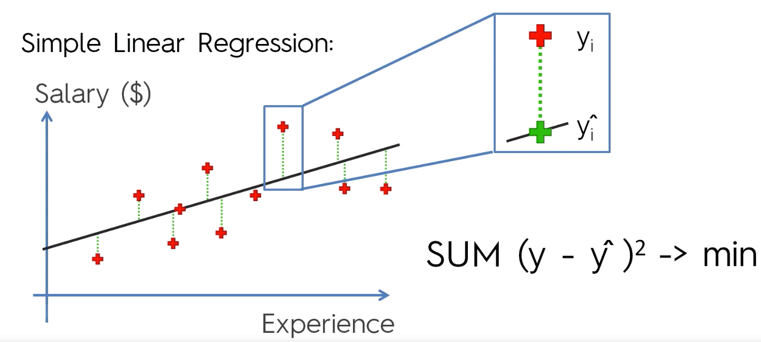
Linear Regression
https://www.udemy.com/machinelearning/learn/v4/content

Slide 13
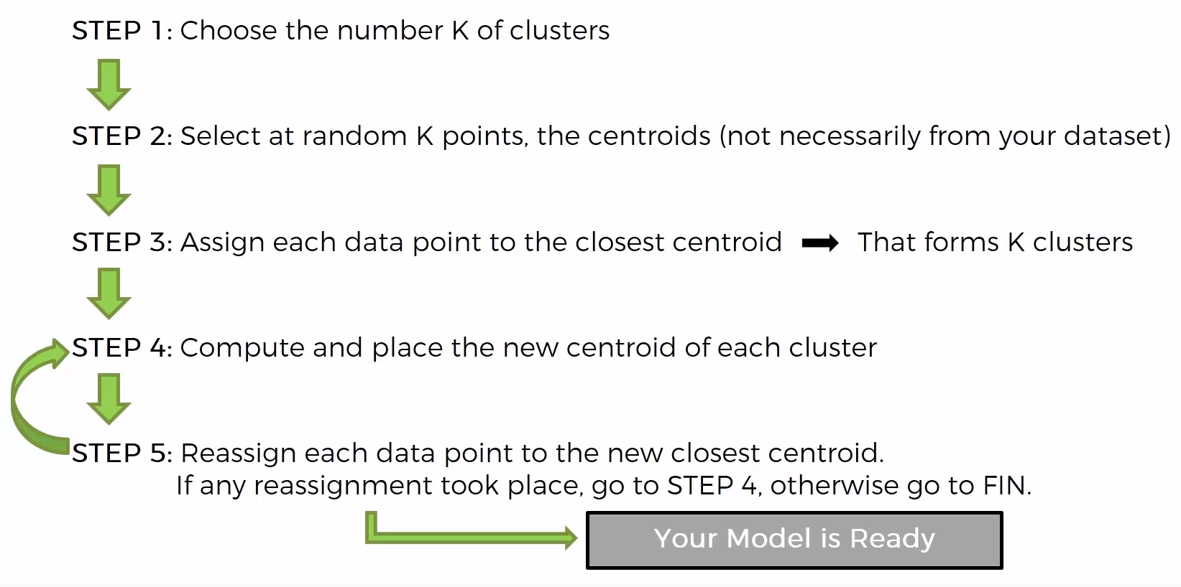
K Means Clustering
https://www.udemy.com/machinelearning/learn/v4/content

Slide 14
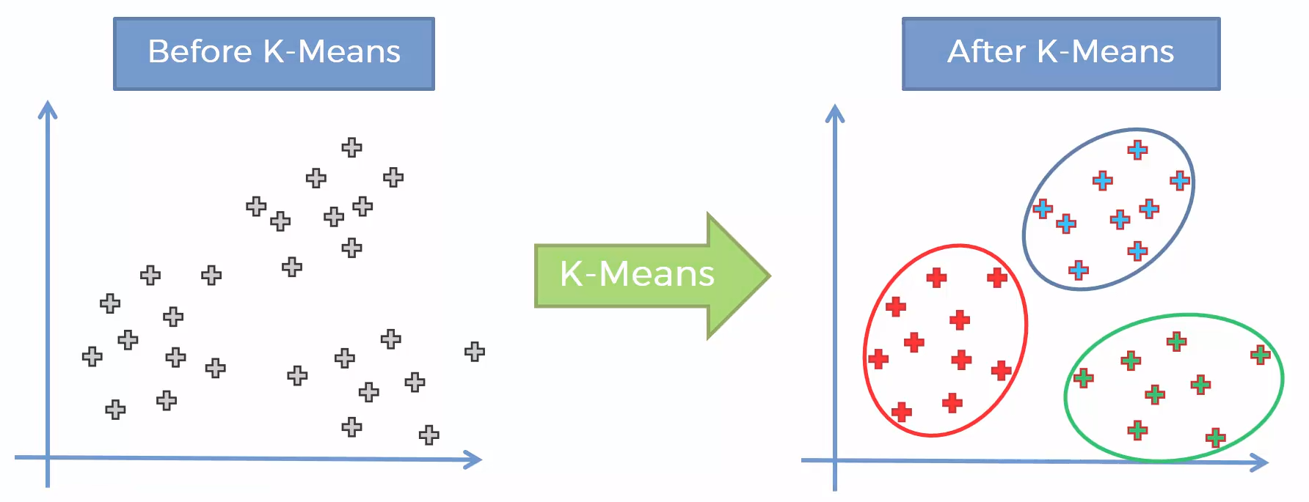
K Means Clustering
https://www.udemy.com/machinelearning/learn/v4/content

Slide 15
Classification

Slide 16
Types of classification algorithms
Nearest Neighbor (k-nearest neighbors (kNN))
Naive Bayes Classifier
Support Vector Machines (SVM)
Decision Trees
Boosted Trees
Random Forest
Neural Networks
https://medium.com/@sifium/machine-learning-types-of-classification-9497bd4f2e14
https://www.analyticsvidhya.com/blog/2017/09/common-machine-learning-algorithms/

Slide 17
k-nearest neighbors (k-NN)

Slide 18
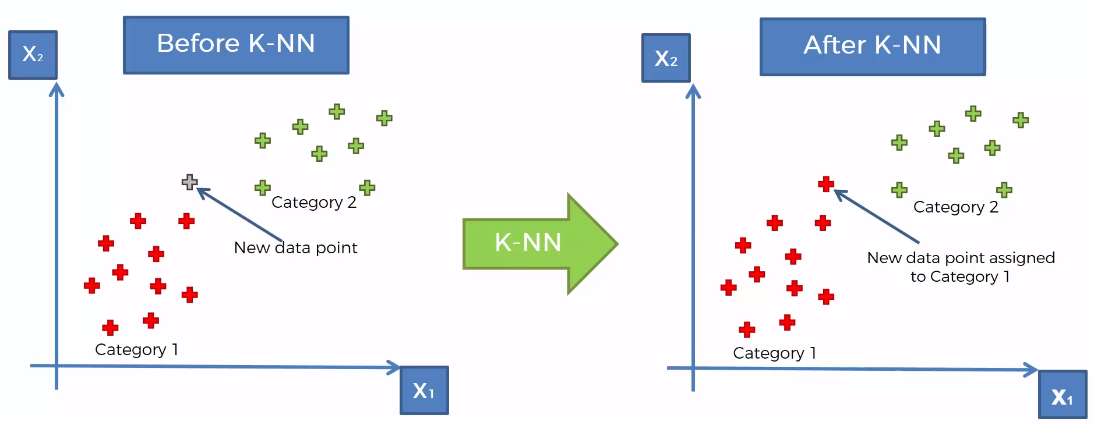
k-nearest neighbors (k-NN)
https://www.udemy.com/machinelearning/learn/v4/content
https://www.quora.com/How-is-the-k-nearest-neighbor-algorithm-different-from-k-means-clustering

Slide 19
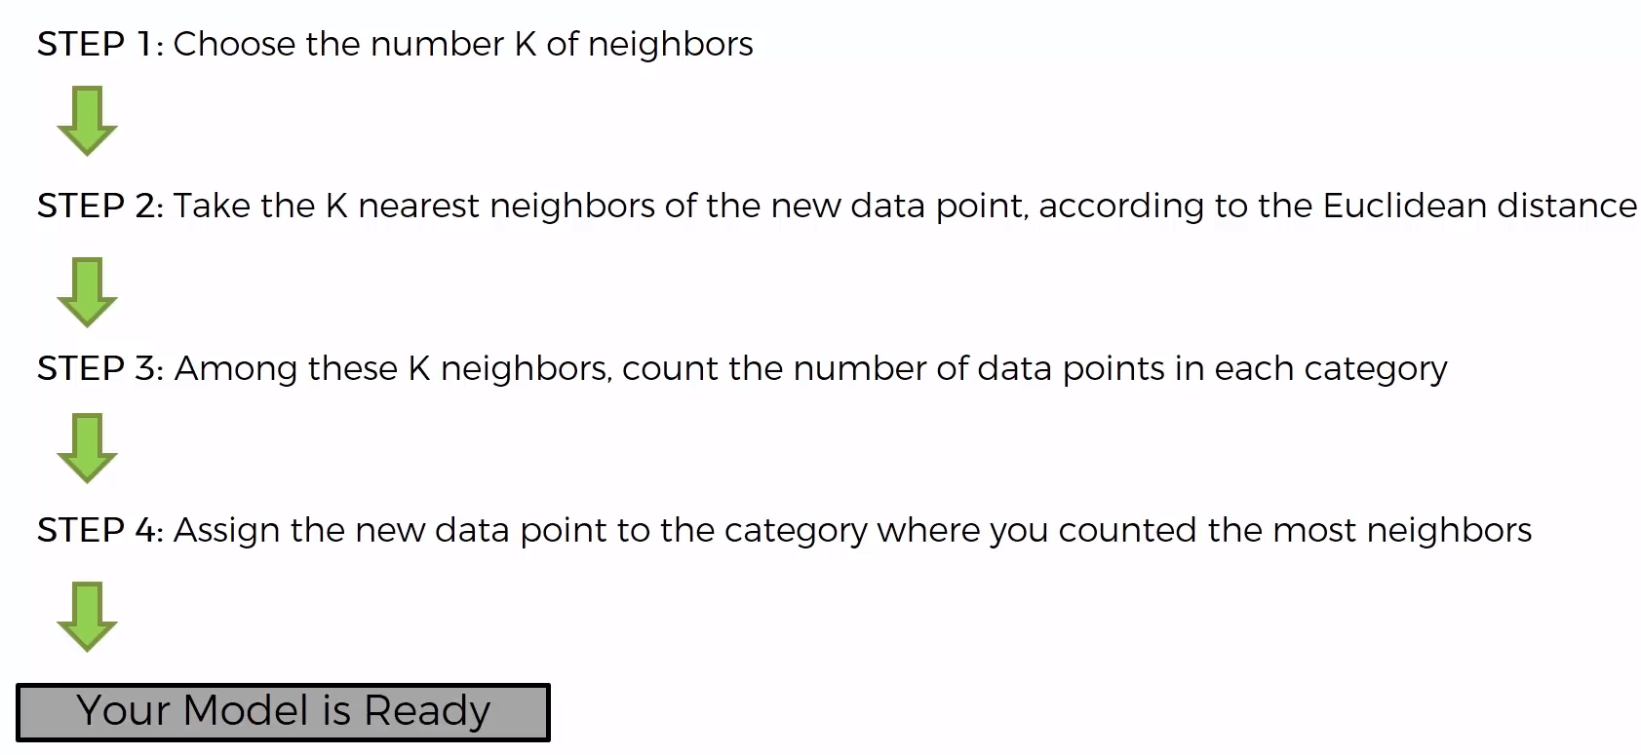
k-nearest neighbors (k-NN)
https://www.udemy.com/machinelearning/learn/v4/content
https://www.quora.com/How-is-the-k-nearest-neighbor-algorithm-different-from-k-means-clustering

Slide 20
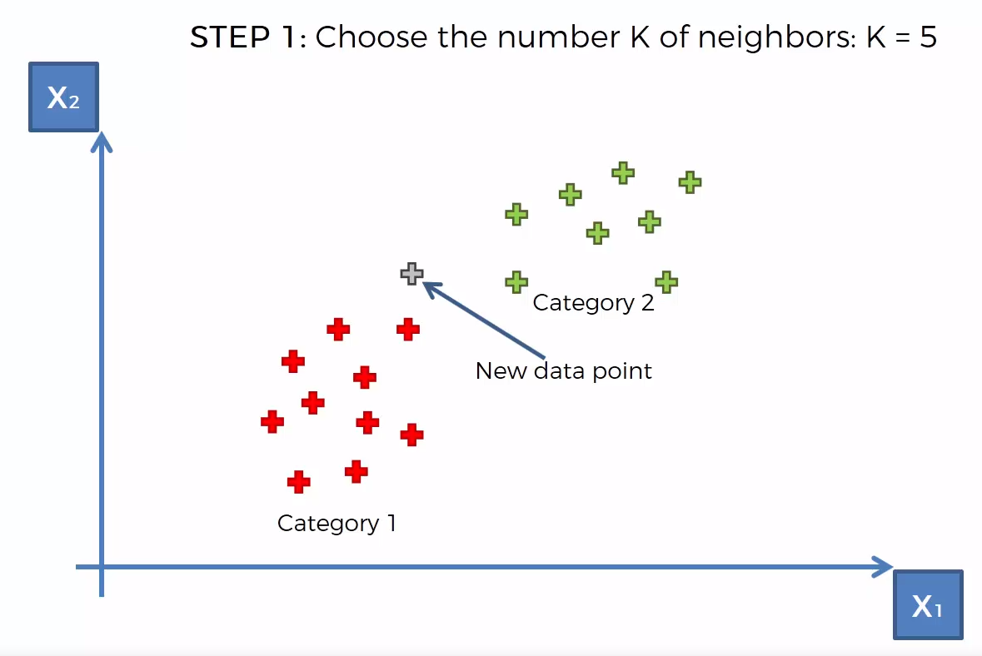
k-nearest neighbors (k-NN)
https://www.udemy.com/machinelearning/learn/v4/content
https://www.quora.com/How-is-the-k-nearest-neighbor-algorithm-different-from-k-means-clustering

Slide 21
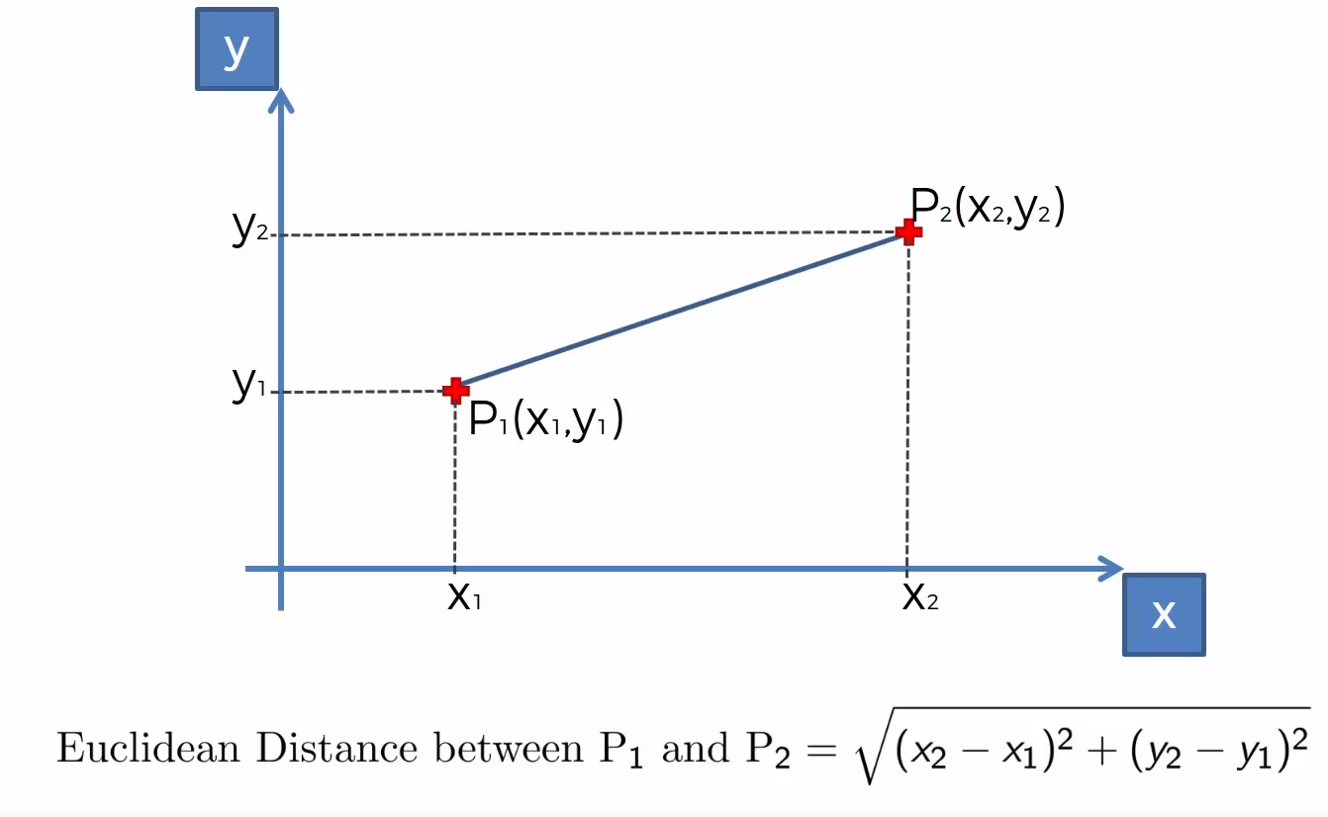
k-nearest neighbors (k-NN)
https://www.udemy.com/machinelearning/learn/v4/content
https://www.quora.com/How-is-the-k-nearest-neighbor-algorithm-different-from-k-means-clustering

Slide 22
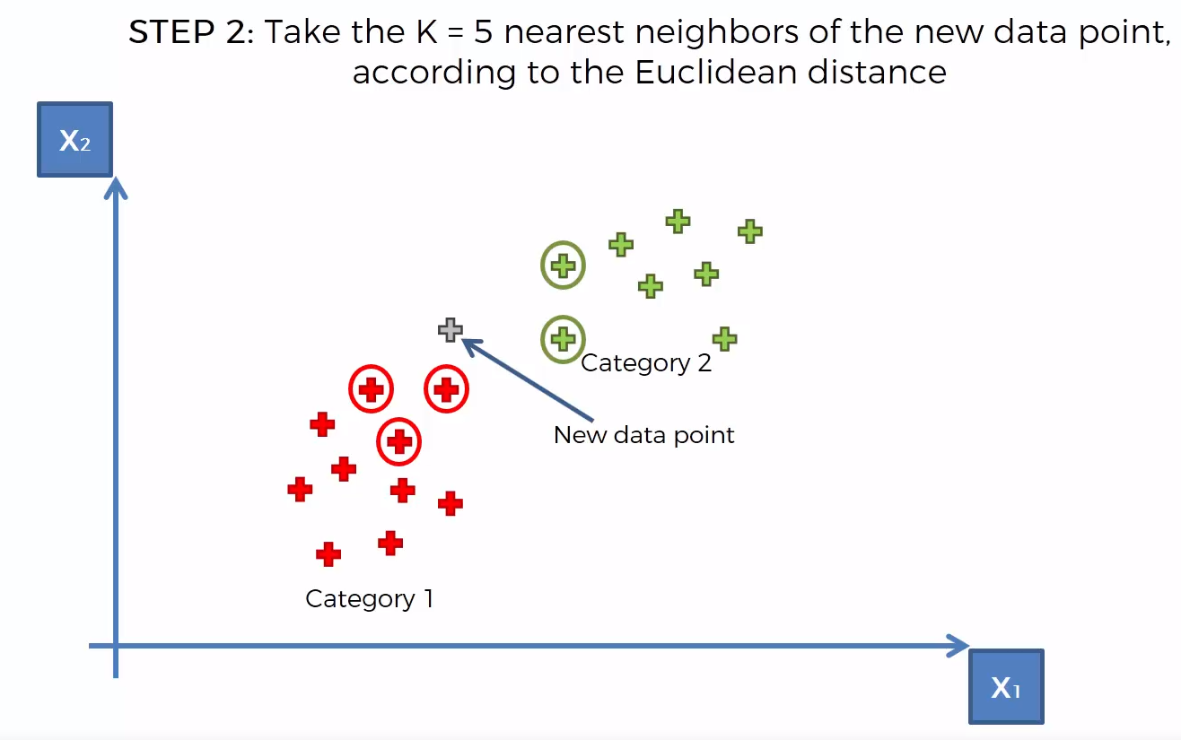
k-nearest neighbors (k-NN)
https://www.udemy.com/machinelearning/learn/v4/content
https://www.quora.com/How-is-the-k-nearest-neighbor-algorithm-different-from-k-means-clustering

Slide 23
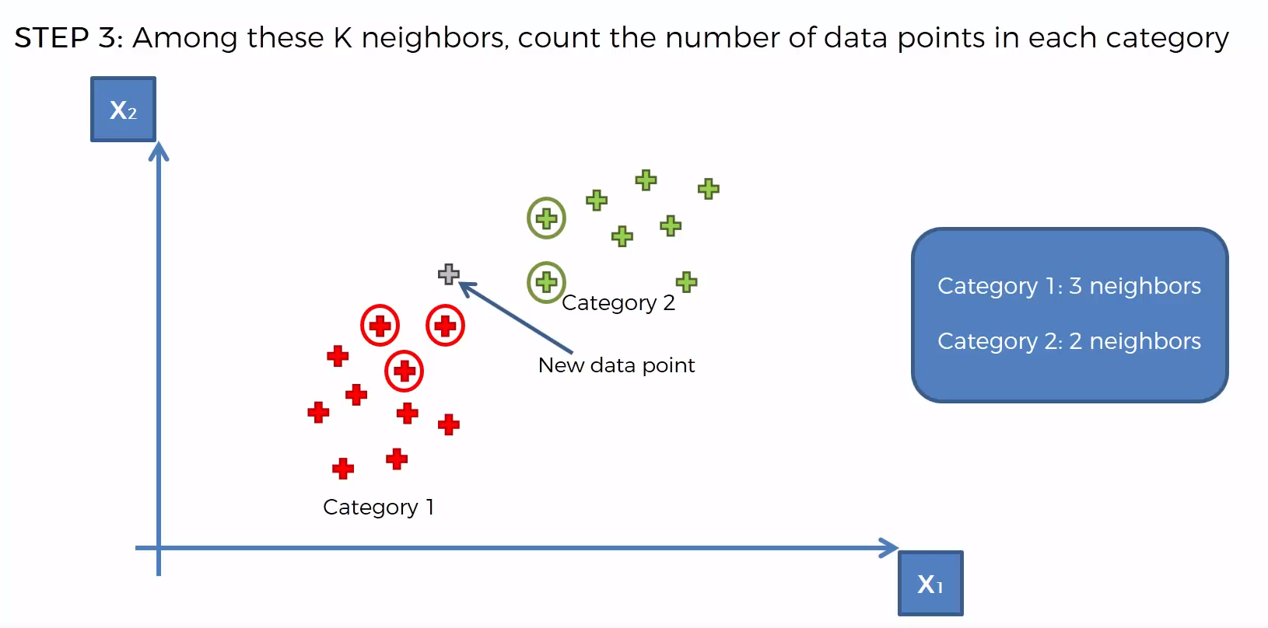
k-nearest neighbors (k-NN)
https://www.udemy.com/machinelearning/learn/v4/content
https://www.quora.com/How-is-the-k-nearest-neighbor-algorithm-different-from-k-means-clustering

Slide 24
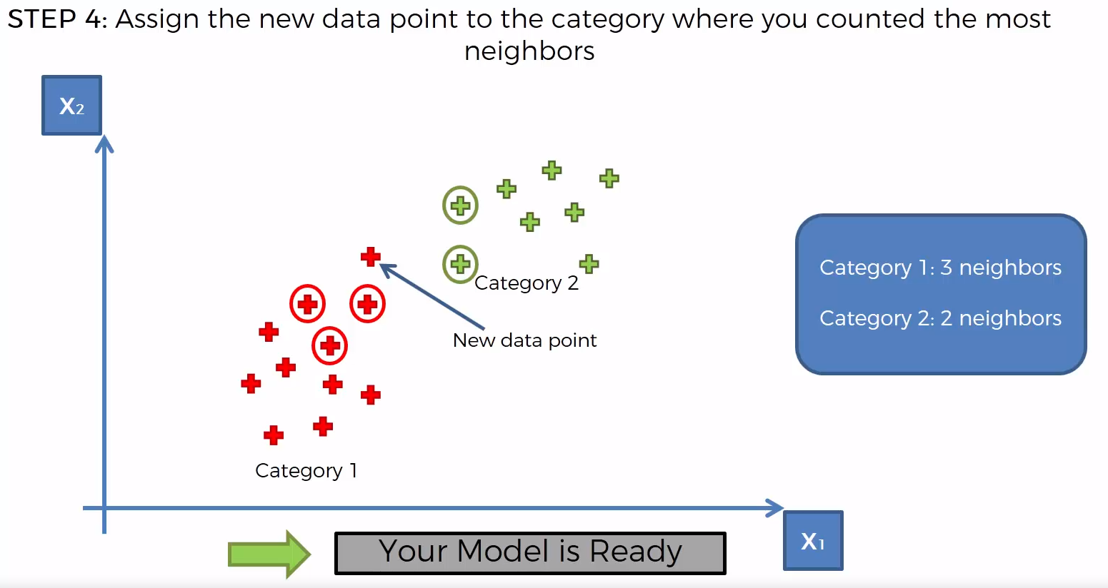
k-nearest neighbors (k-NN)
https://www.udemy.com/machinelearning/learn/v4/content
https://www.quora.com/How-is-the-k-nearest-neighbor-algorithm-different-from-k-means-clustering

Slide 25
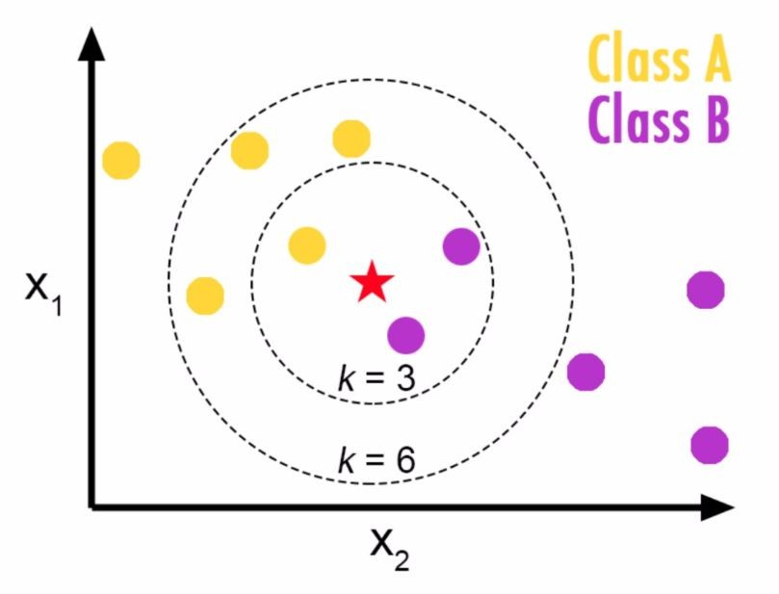
k-nearest neighbors (k-NN)
Choosing a K will affect what class a new point is assigned to:

Slide 26
Naive Bayes Classifier

Slide 27
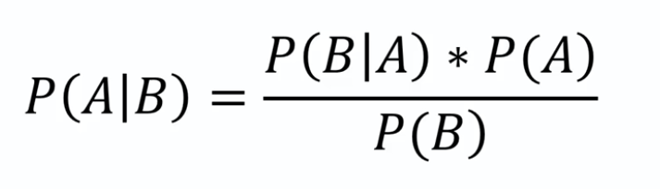
Naive Bayes Classifier
It is a classification technique based on Bayes’ Theorem with an assumption of independence among predictors. In simple terms, a Naive Bayes classifier assumes that the presence of a particular feature in a class is unrelated to the presence of any other feature
Bayes’ Theorem
https://medium.com/@sifium/machine-learning-types-of-classification-9497bd4f2e14

Slide 28
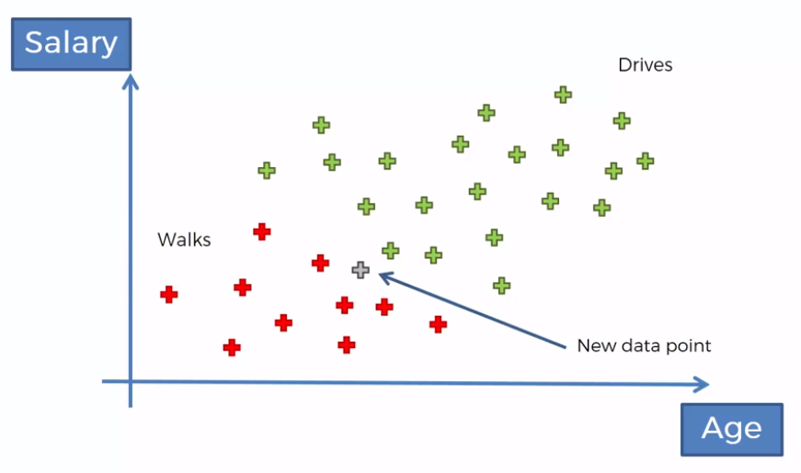
Naive Bayes Classifier
https://www.udemy.com/machinelearning/learn/v4/content
https://medium.com/@sifium/machine-learning-types-of-classification-9497bd4f2e14

Slide 29
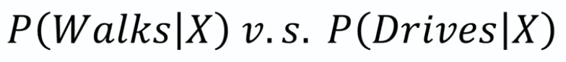
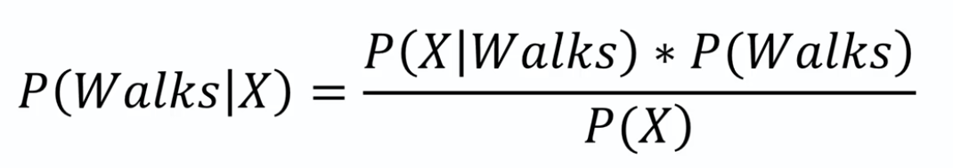
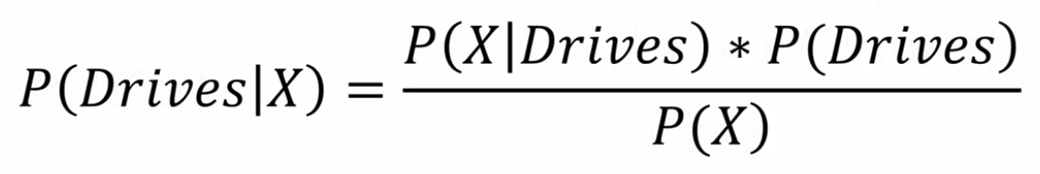
Naive Bayes Classifier
https://www.udemy.com/machinelearning/learn/v4/content
https://medium.com/@sifium/machine-learning-types-of-classification-9497bd4f2e14

Slide 30
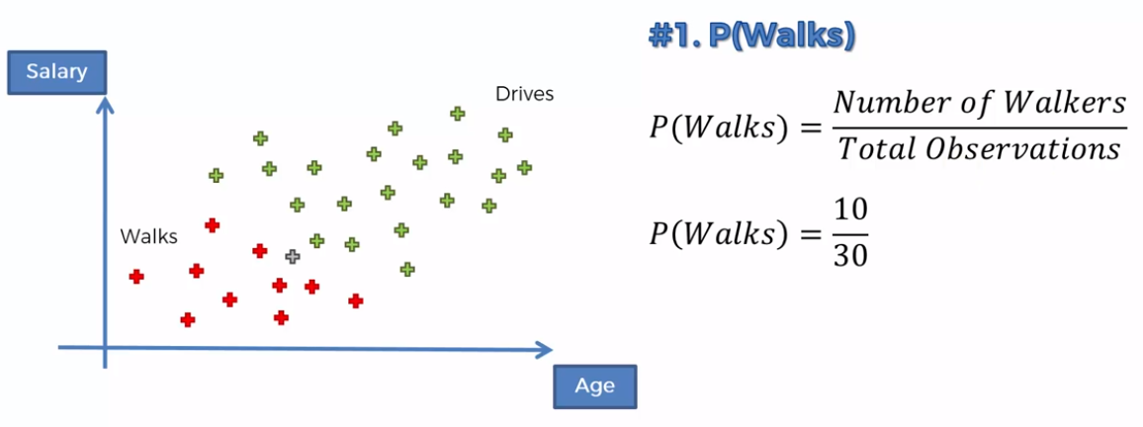
Naive Bayes Classifier
https://www.udemy.com/machinelearning/learn/v4/content
https://medium.com/@sifium/machine-learning-types-of-classification-9497bd4f2e14

Slide 31
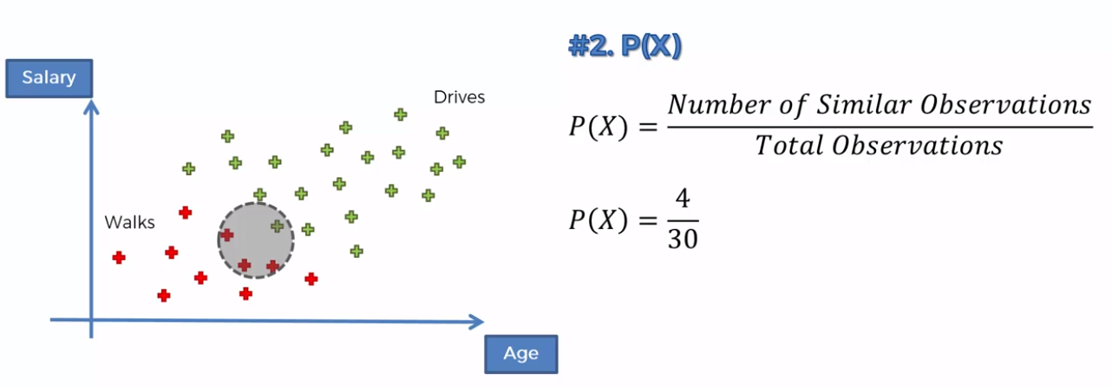
Naive Bayes Classifier
https://www.udemy.com/machinelearning/learn/v4/content
https://medium.com/@sifium/machine-learning-types-of-classification-9497bd4f2e14

Slide 32
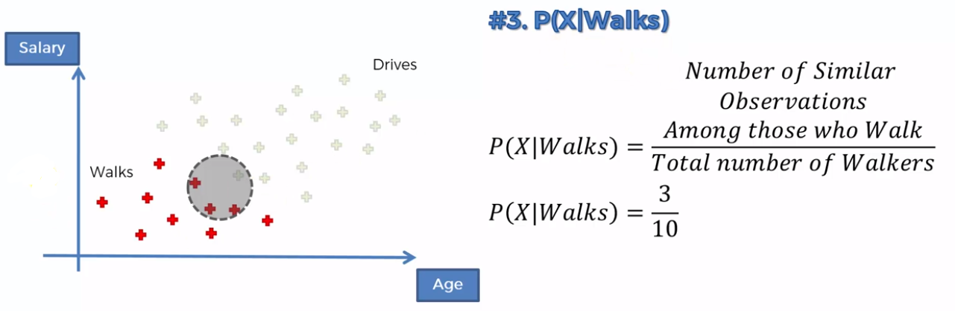
Naive Bayes Classifier
https://www.udemy.com/machinelearning/learn/v4/content
https://medium.com/@sifium/machine-learning-types-of-classification-9497bd4f2e14

Slide 33
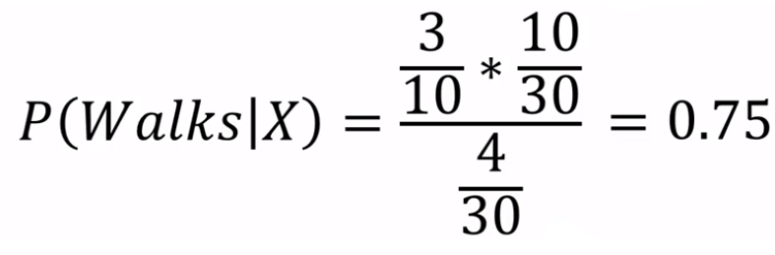
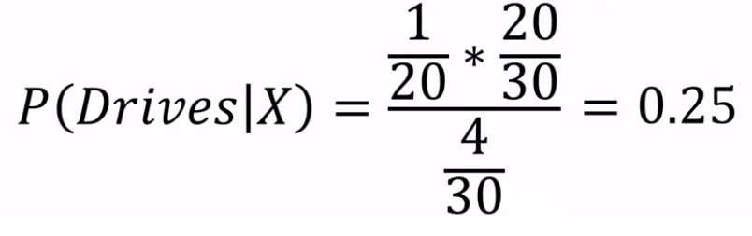
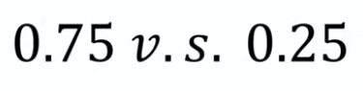
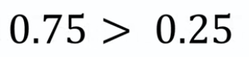
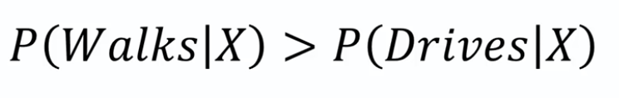
Naive Bayes Classifier
https://www.udemy.com/machinelearning/learn/v4/content
https://medium.com/@sifium/machine-learning-types-of-classification-9497bd4f2e14

Slide 34
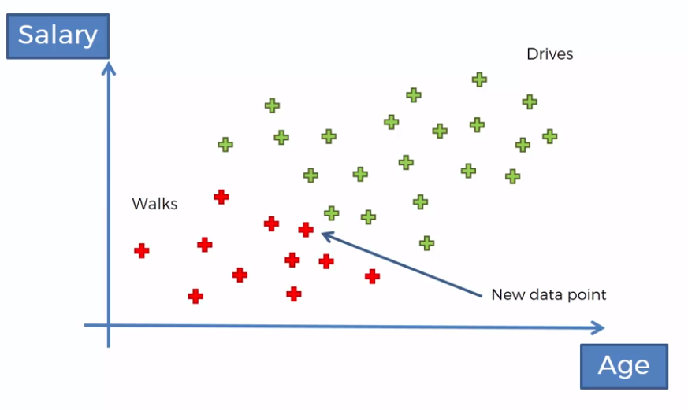
Naive Bayes Classifier
https://www.udemy.com/machinelearning/learn/v4/content
https://medium.com/@sifium/machine-learning-types-of-classification-9497bd4f2e14

Slide 35
Support Vector Machines (SVM)

Slide 36
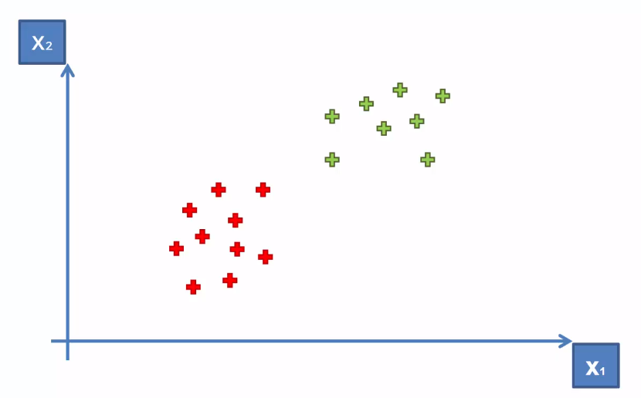
Support Vector Machines (SVM)
Purpose of the classifier is how we can create a boundary between two classes
How can we separate these points?
https://www.udemy.com/machinelearning/learn/v4/content
https://medium.com/@sifium/machine-learning-types-of-classification-9497bd4f2e14

Slide 37
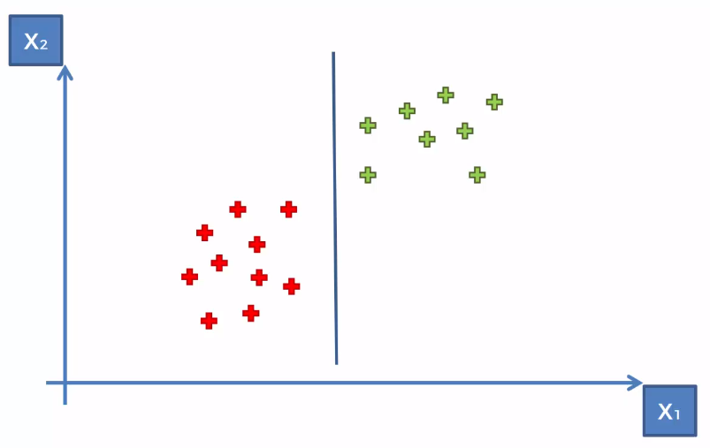
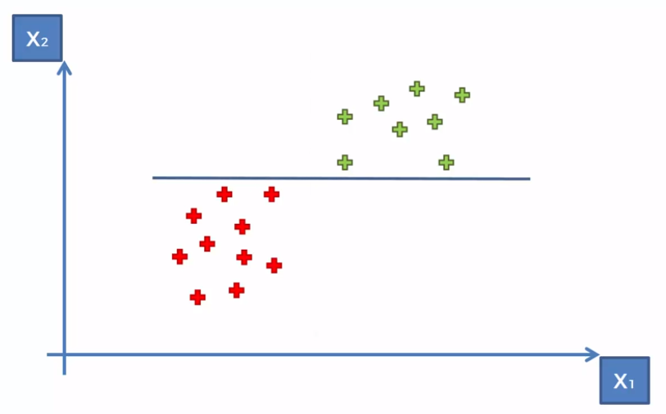
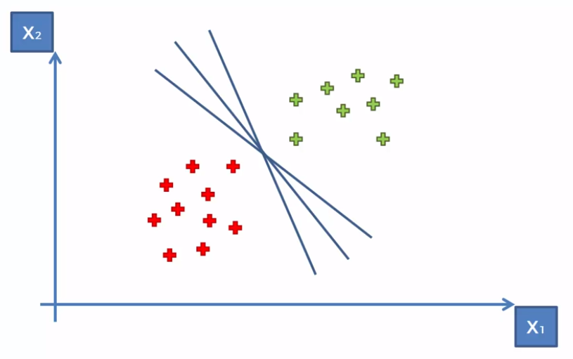
Support Vector Machines (SVM)
How can we separate these points?
https://www.udemy.com/machinelearning/learn/v4/content
https://medium.com/@sifium/machine-learning-types-of-classification-9497bd4f2e14

Slide 38
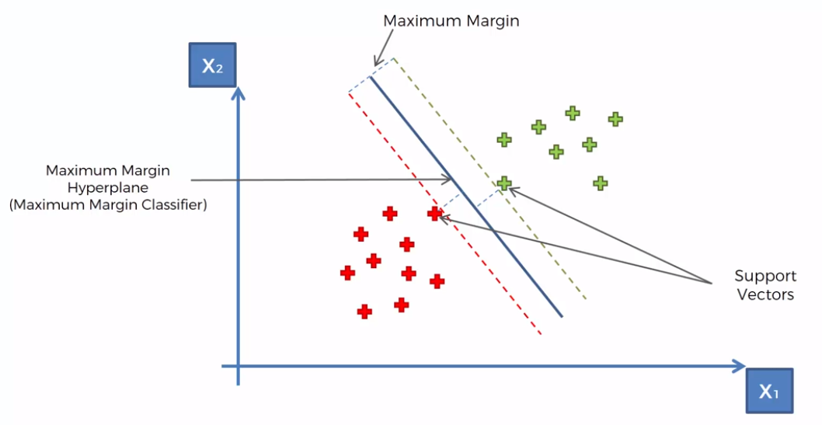
Support Vector Machines (SVM)
https://www.udemy.com/machinelearning/learn/v4/content
https://medium.com/@sifium/machine-learning-types-of-classification-9497bd4f2e14

Slide 39
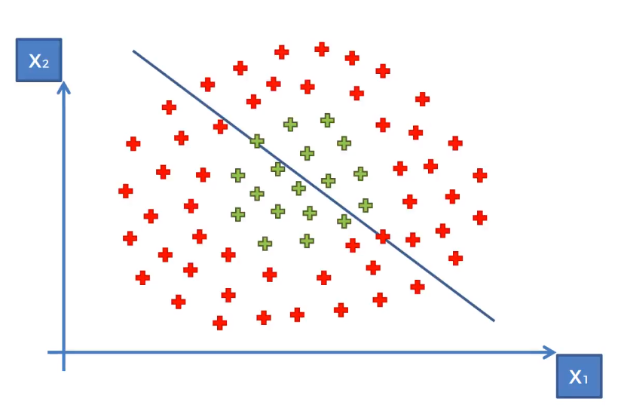
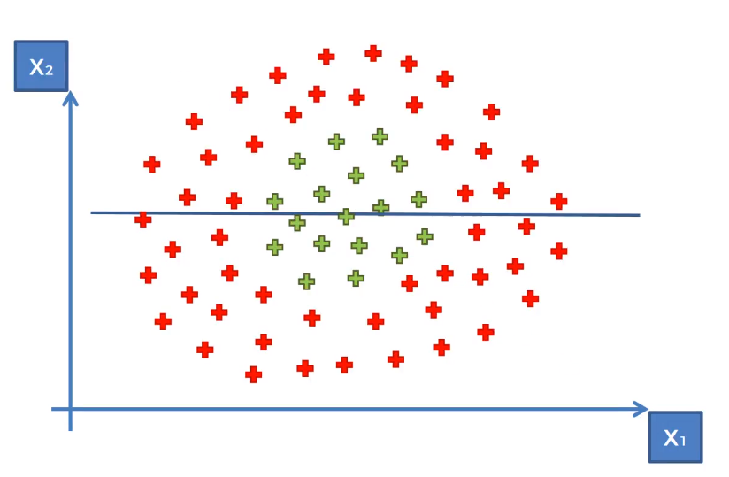
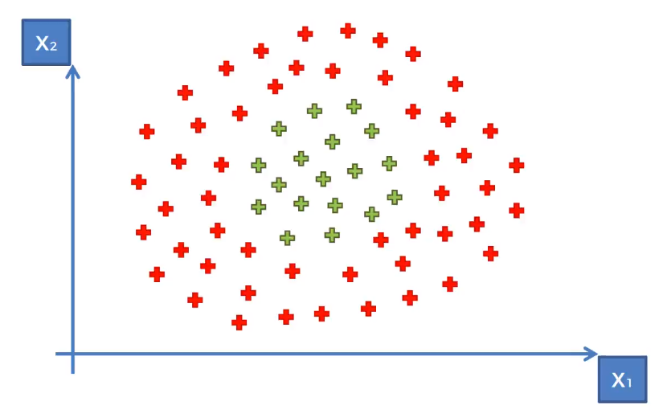
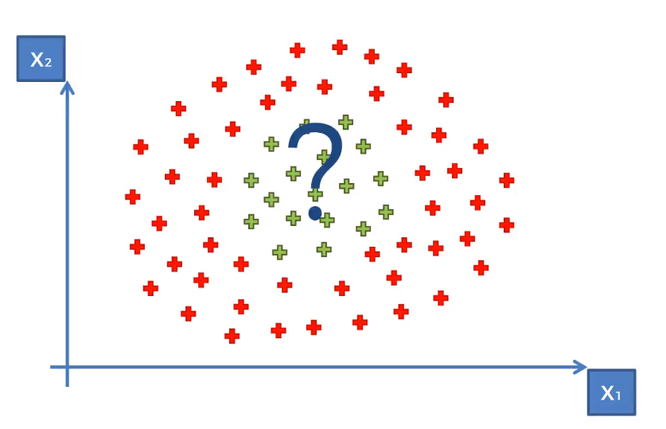
Kernel SVM
What about these points?
https://www.udemy.com/machinelearning/learn/v4/content
https://medium.com/@sifium/machine-learning-types-of-classification-9497bd4f2e14

Slide 40
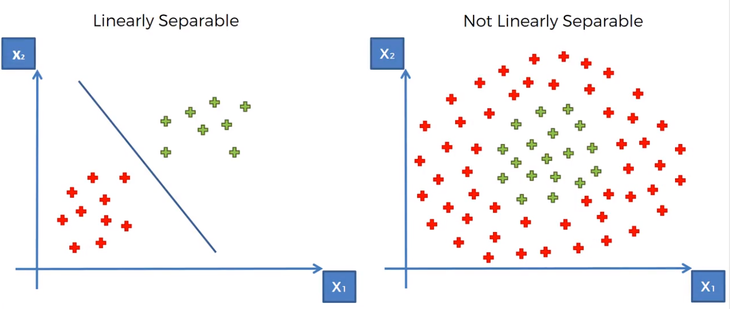
Kernel SVM
Liner Separability
https://www.udemy.com/machinelearning/learn/v4/content
https://medium.com/@sifium/machine-learning-types-of-classification-9497bd4f2e14

Slide 41
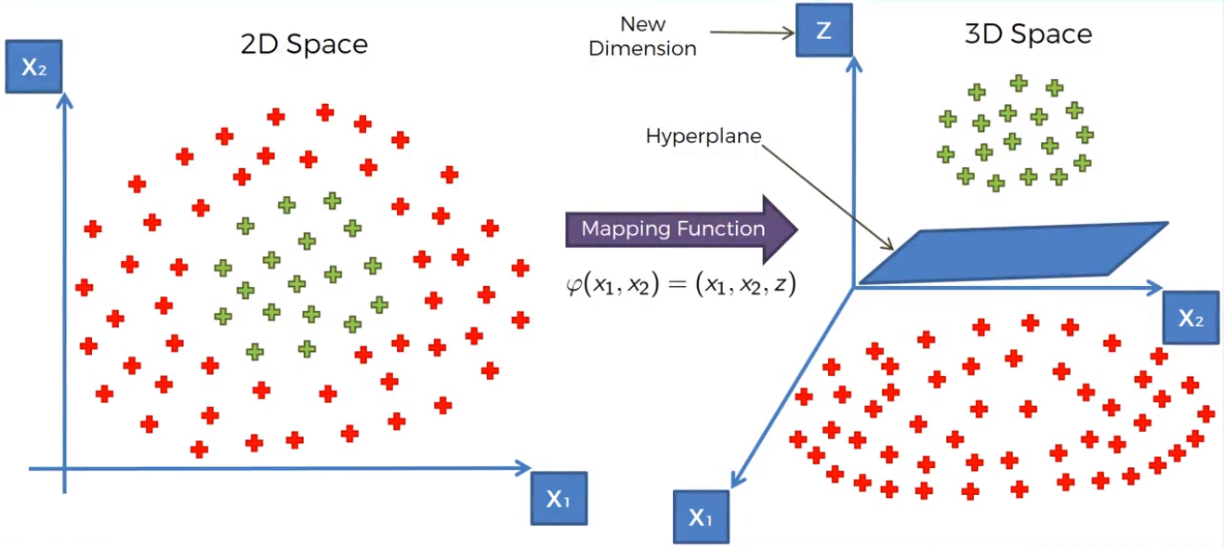
Kernel SVM
Mapping to higher dimension
https://www.udemy.com/machinelearning/learn/v4/content
https://medium.com/@sifium/machine-learning-types-of-classification-9497bd4f2e14

Slide 42
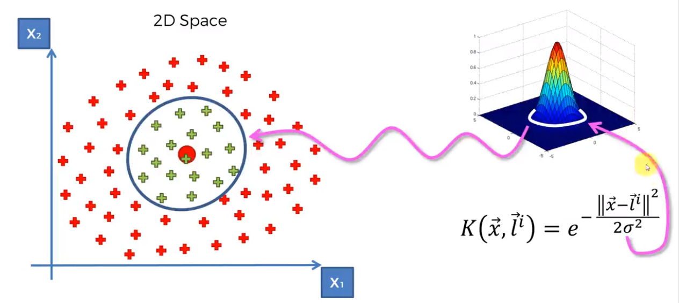
Kernel SVM
The Gaussian RBF Kernel
https://www.udemy.com/machinelearning/learn/v4/content
https://medium.com/@sifium/machine-learning-types-of-classification-9497bd4f2e14

Slide 43
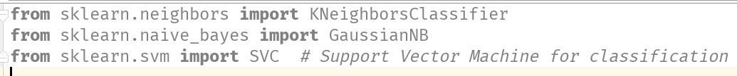
Scikit-Learn libraries for classifiers
http://scikit-learn.org/stable/auto_examples/classification/plot_classifier_comparison.html

Slide 44
How to know our model is good

Slide 45
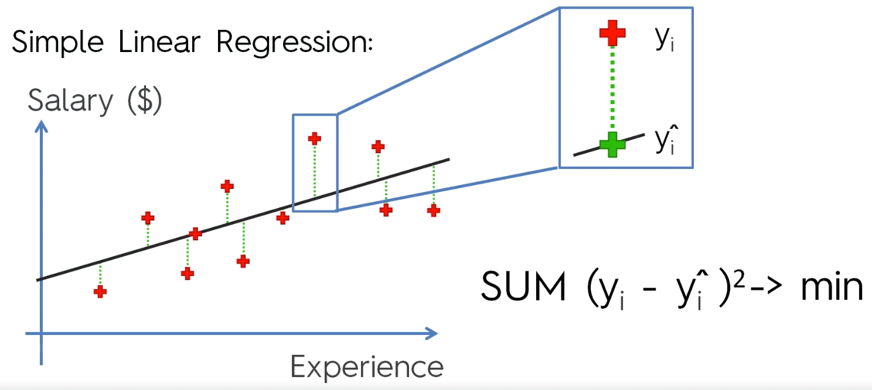
Regression
Sum of Squares Error - SSE
https://en.wikipedia.org/wiki/Residual_sum_of_squares

Slide 46
Clustering
How much the interclass similarity is minimized and intraclass similarity is maximized
Adjusted Rand index
Mutual Information based scores
http://scikit-learn.org/stable/modules/clustering.html

Slide 47
Classification
False Positives & False Negatives
Confusion Matrix
Accuracy Paradox
Precision
Recall
F1 score

Slide 48
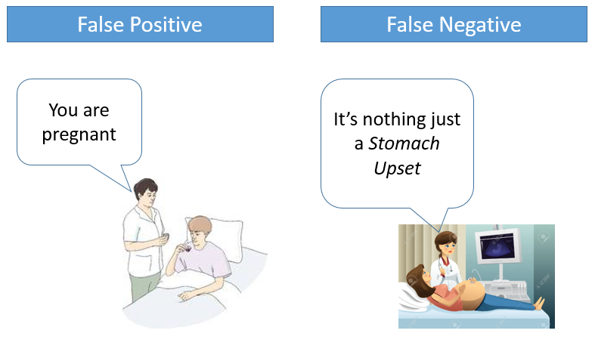
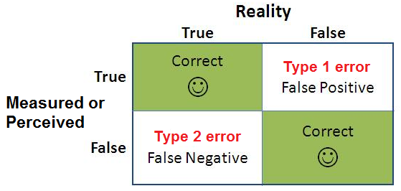
False Positives & False Negatives
A false positive is where you receive a positive result for a test, when you should have received a negative results. A false positive is usually called a Type I error.
A false negative is where you receive a negative test result, but you should have got a positive test result . A false negative is usually called a Type II error.
http://www.statisticshowto.com/false-positive-definition-and-examples/

Slide 49

Metrics
accuracy =
true positives + true negatives / total
precision =
true positives / (true positives + false positives)
recall =
true positives / (false negatives + true positives)
F1 score =
2 * ((precision * recall) / (precision + recall))

Slide 50
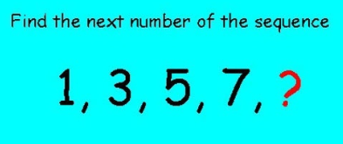
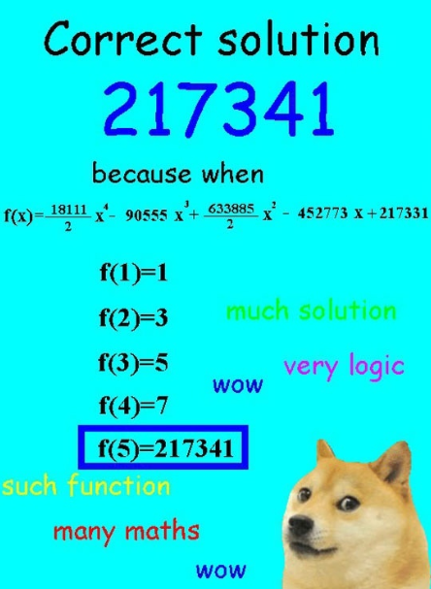
Bias Error
Machine Learning algorithms are often run the risk of over-extrapolating or over-interpolating from the data that they are trained on.
https://ml.berkeley.edu/blog/2017/07/13/tutorial-4/

Slide 51
Variance Error
Variance is the amount that the estimate of the target function will change if different training data was used.
Variance measures how far a data set is spread out. The technical definition is “The average of the squared differences from the mean”
The data set 12, 12, 12, 12, 12 has a var. of zero (the numbers are identical).
The data set 12, 12, 12, 12, 13 has a var. of 0.167; a small change in the numbers equals a very small var.
The data set 12, 12, 12, 12, 13,013 has a var. of 28171000; a large change in the numbers equals a very large number.
https://machinelearningmastery.com/gentle-introduction-to-the-bias-variance-trade-off-in-machine-learning/

Slide 52
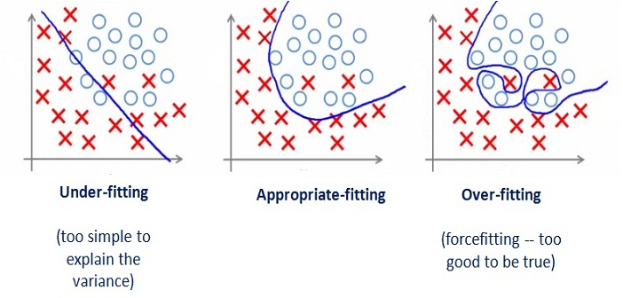
Underfitting and Overfitting
Underfitting occurs if the model or algorithm shows low variance but high bias
Overfitting occurs if the model or algorithm shows low bias but high variance.

Slide 53
Cross Validation (classification)
Cross-validation is a powerful preventative measure against overfitting.
Assess how model will generalize to independent data set (e.g. data not in the training set).
Divide data into training and test splits
Fit model on training, predict on test
Determine accuracy, precision and recall
Repeat k times with different splits then average as F1

Slide 54
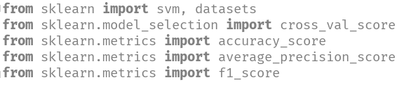
Scikit-Learn libraries for evaluation
http://scikit-learn.org/stable/modules/model_evaluation.html

Slide 55
Evaluation Procedure: Train/Test split
Split the dataset into two sets
Train the model on the Training set
Test the model on the Testing Set, and evaluate how well we did

Slide 56
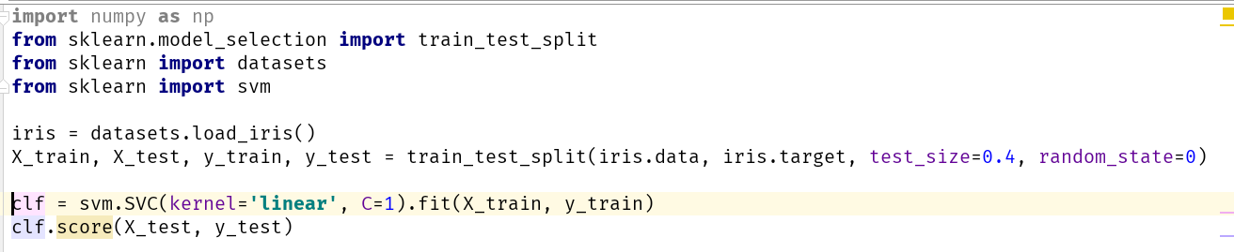
Cross Validation in Scikit-Learn

Slide 57
Use case: classifying colors of fruit

Slide 58
Reading data
fruits = pd.read_table('fruit_data_with_colors.txt’)
fruits.head()
fruit_label fruit_name fruit_subtype mass width height color_score
1 apple granny_smith 192 8.4 7.3 0.55
1 apple granny_smith 180 8.0 6.8 0.59
1 apple granny_smith 176 7.4 7.2 0.60
2 mandarin mandarin 86 6.2 4.7 0.80
2 mandarin mandarin 84 6.0 4.6 0.79

Slide 59
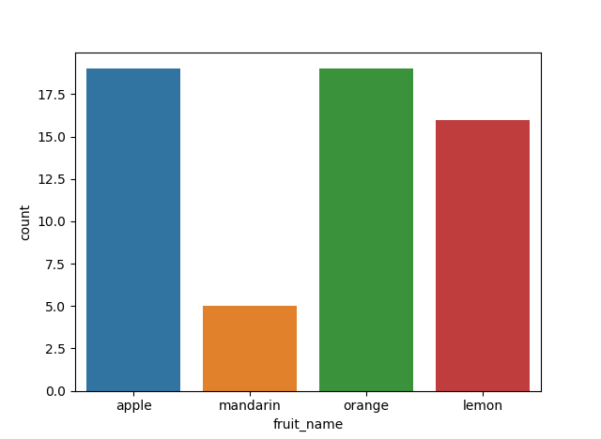
How many of each category
import seaborn as sns sns.countplot(fruits['fruit_name'],label="Count") plt.show()

Slide 60
Fitting model
from sklearn.svm import SVC X = fruits[['mass', 'width', 'height', 'color_score']] y = fruits['fruit_label'] X_train, X_test, y_train, y_test = train_test_split(X, y, random_state=0) svm = SVC() svm.fit(X_train, y_train)

Slide 61
Evaluating model
print('Accuracy of SVM classifier on training set: {:.2f}' .format(svm.score(X_train, y_train))) print('Accuracy of SVM classifier on test set: {:.2f}' .format(svm.score(X_test, y_test)))
Accuracy of SVM classifier on training set: 0.91
Accuracy of SVM classifier on test set: 0.47

Slide 62
References
https://www.analyticsvidhya.com/blog/2017/09/common-machine-learning-algorithms/

Slide 63

Iris Dataset
This data sets consists of 3 different types of irises' (Setosa, Versicolour, and Virginica) petal and sepal length, stored in a 150x4 numpy.ndarray
The rows being the samples and the columns being: Sepal Length, Sepal Width, Petal Length and Petal Width

